Slide 1
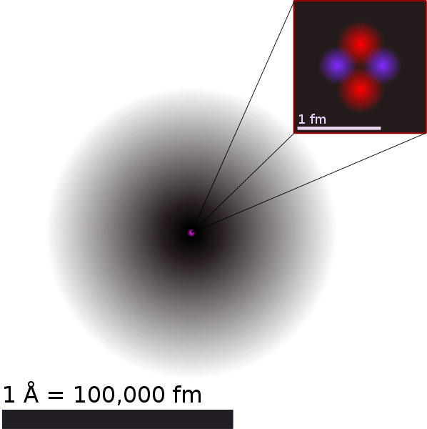
Helium Atom
Notes:
The atom is a basic unit of matter that consists of a dense central nucleus surrounded by a cloud of negatively charged electrons. The atomic nucleus contains a mix of positively charged protons and electrically neutral neutrons (except in the case of hydrogen-1, which is the only stable nuclide with no neutrons). The electrons of an atom are bound to the nucleus by the electromagnetic force. Likewise, a group of atoms can remain bound to each other, forming a molecule. An atom containing an equal number of protons and electrons is electrically neutral, otherwise it has a positive charge if there are fewer electrons (electron deficiency) or negative charge if there are more electrons (electron excess). A positively or negatively charged atom is known as an ion. An atom is classified according to the number of protons and neutrons in its nucleus: the number of protons determines the chemical element, and the number of neutrons determines the isotope of the element.[1]

Slide 2
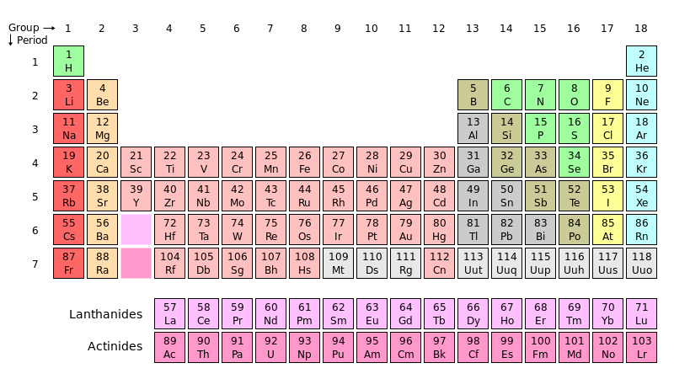
Periodic Table
Notes:
Show Helium Atom

Slide 3
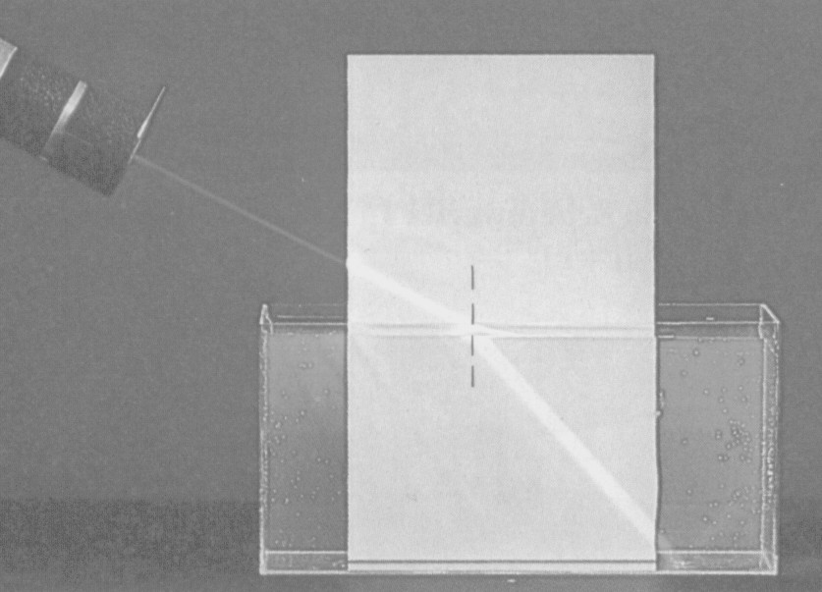
Light Refraction
Notes:
Light Refraction when changing Medium

Slide 4
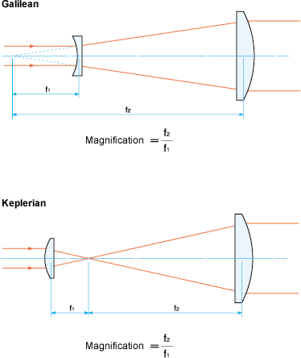
Notes:
Light Refraction on Lenses (Change of medium)

Slide 5
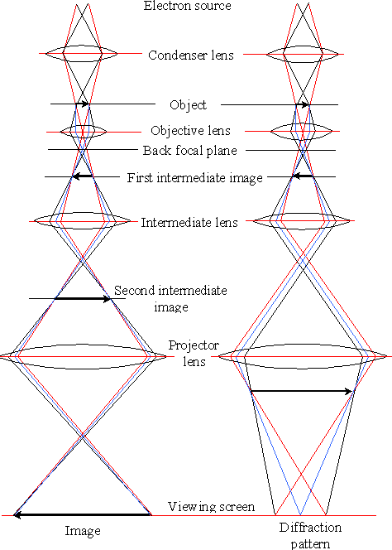
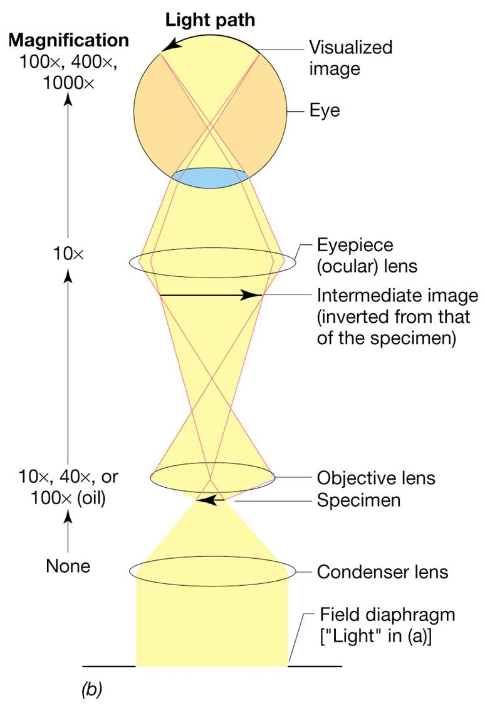
Electron Microscope
Light Microscope
Notes:
The electron microscope uses electrostatic and electromagnetic "lenses" to control the electron beam and focus it to form an image. These lenses are analogous to, but different from the glass lenses of an optical microscope that form a magnified image by focusing light on or through the specimen.

Slide 6
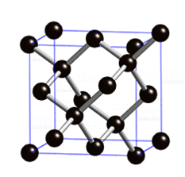
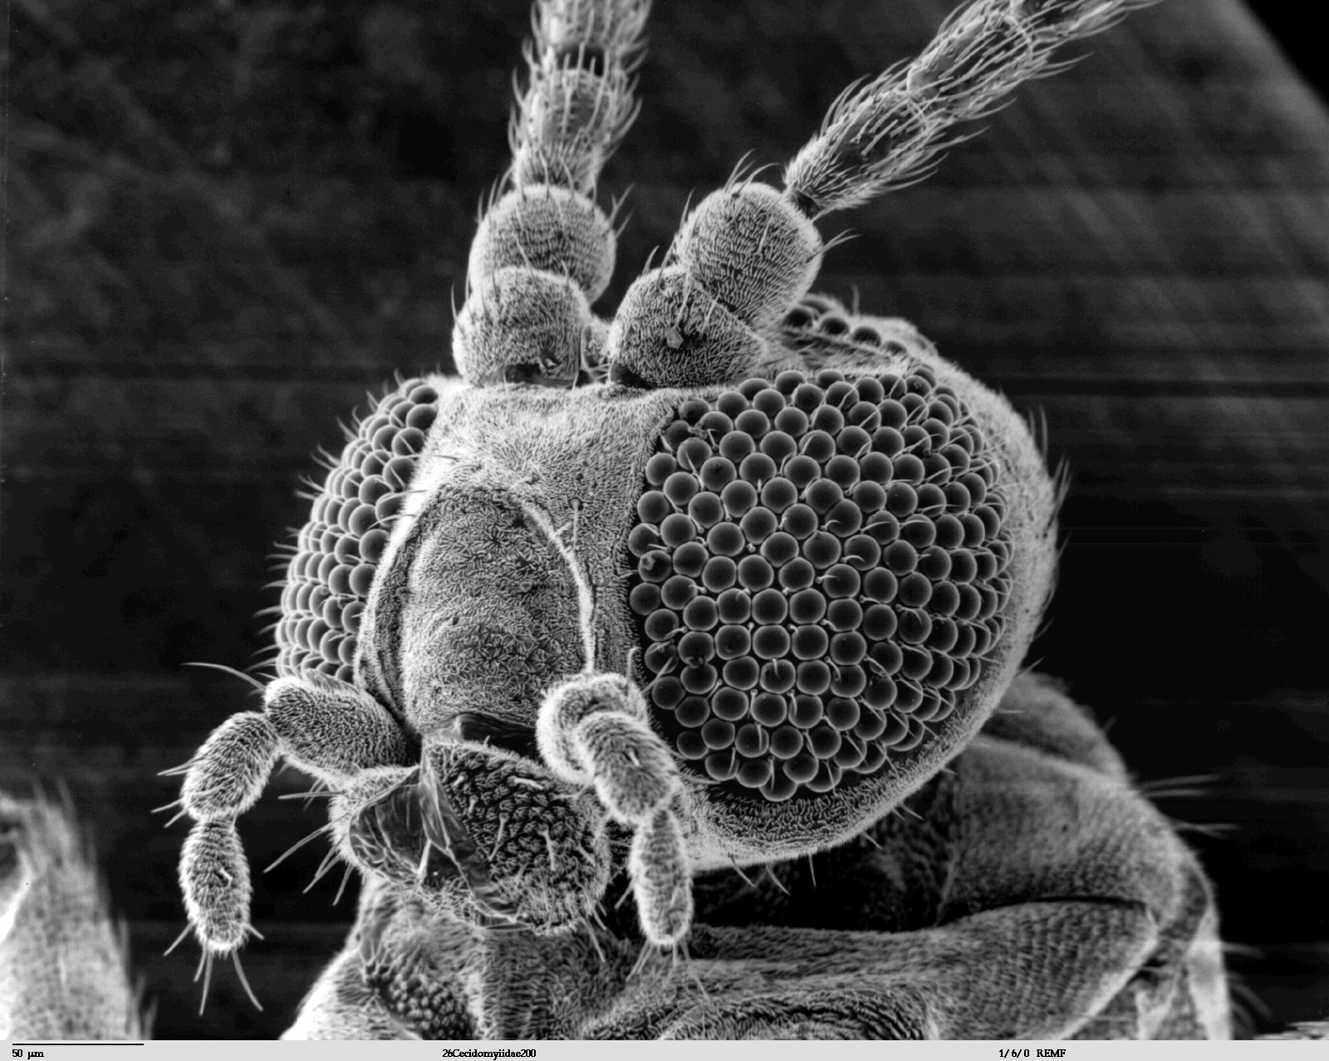

Electron Microscope Pictures
Diamond
Insect
Model
Single Aroms „visible“
Notes:
1 Angström (o,1 nm)
Each

Slide 7
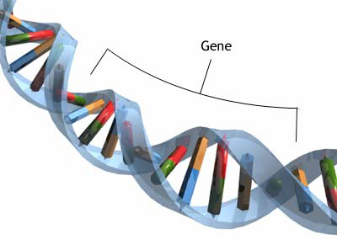
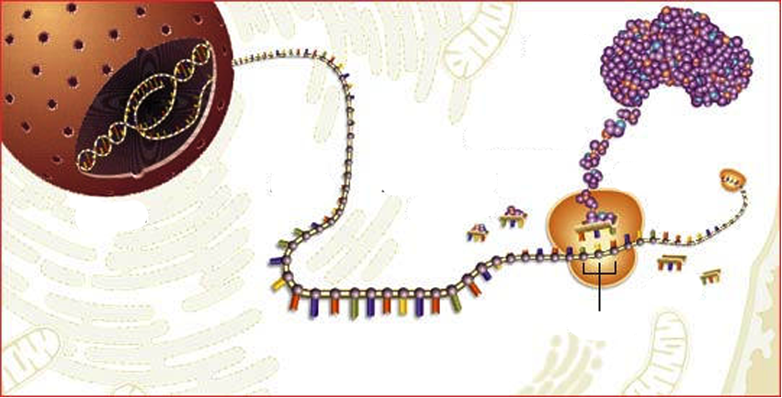
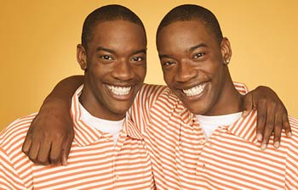
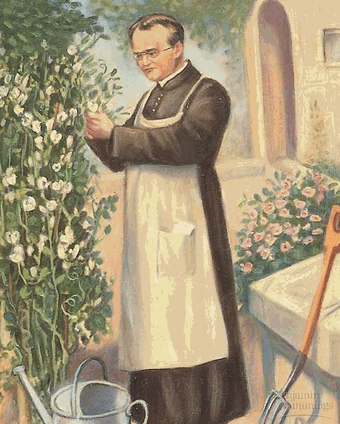
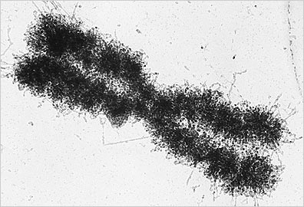
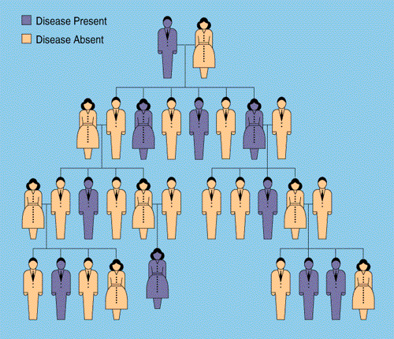
GENETICS
Notes:
Genetics: The branch of biology that deals with heredity, especially the mechanisms and the principles of transmitting hereditable traits to the next generation.
...we will get to know for example why we look (for ex. same eye color) similar to our parents, but not exactly the same?
Mendel... rules... exercises, applying these rules... genetics in humans (genetically inherited
diseases)... some exercise their to to apply our knowledge.
- Then we will have a look on what happens on the molecular level: „what“ is it, that is transmitted from one generation to the next and then defines how the organism will look like. Means what kind of molecules are involved.... we have to be aware that we are dealing with completely different dimensions!!!
- whenever there is the possibility or if there are questions about evolution, we will talk about evolution as well, since genetics and evolution are very much related to each other.
- During the last week I want to discuss with you 2 chapters of the book from H H the Dalai Lama. The universe in a single atom: one about „evolution and ....“ the other about „ethics and the new genetics“
There H H The Dalai Lama calls attention to think about the far- reaching consequences that the application of the genetical knowledge and its technics can have on our lifes as human beings and for every living thing on the earth.... we have to be very clear about what we are doing and if our actions are in harmony with our ethical values.
...during the first weeks we are building up knowledge that should help us to argue with a well founded scientific genetic background.

Slide 8
CLASSICAL GENETICS

Slide 9
MOLECULAR GENETICS

Slide 10
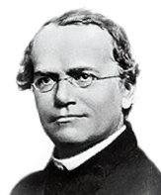
CLASSICAL GENETICS
Gregor Mendel: 1822- 1884
Notes:
Gregor Johann Mendel (1822 – 1884) was an Austrian scientist and monk.
Posthumous fame as the founder of the new science of genetics.

Slide 11
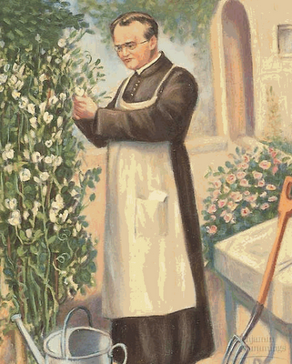
Mendel did experiments with pea plants
Notes:
Mendel demonstrated that the inheritance of certain traits in pea plants follows particular patterns
Although the significance of Mendel's work was not recognized until the turn of the 20th century, the independent rediscovery of these laws formed the foundation of the modern science of genetics.

Slide 12

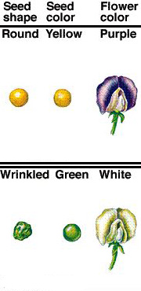

Slide 13
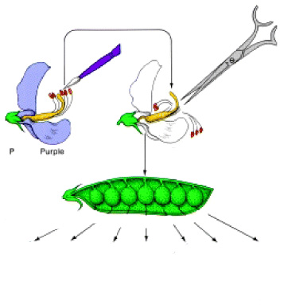
Crosspollination
?

Slide 14
Transmission of the trait „seed color“ over generations
P:
Parents
F1:
F1: First generation
F1:
F2:
F2: Second generation
...the same happened with other features (color of petals, shape of seeds)

