Slide 1
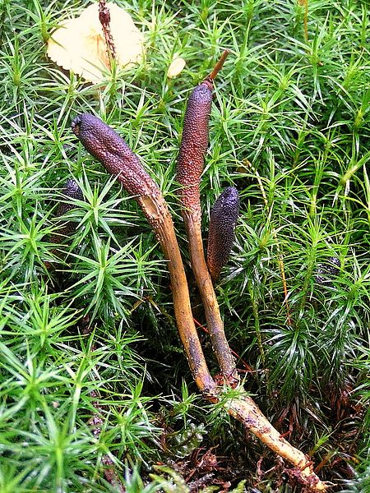
„Yartsa Gunbu“ (Cordyceps= Fungus)
Notes:
Cordyceps is a genus of ascomycete fungi (sac fungi) that includes about 400 described species. All Cordyceps species are endoparasitoids, mainly on insects and other arthropods (they are thus entomopathogenic fungi); a few are parasitic on other fungi. The best known species of the genus is Cordyceps sinensis,[1] first recorded as yartsa gunbu in Tibet in the 15th Century.[2] It is known as yarsha gumba in Nepal. The Latin etymology describes cord as club, ceps as head, and sinensis as Chinese. Cordyceps sinensis, known in English commonly as caterpillar fungus, is considered a medicinal mushroom in oriental medicines, such as traditional Chinese medicines[3][unreliable source?] and traditional Tibetan medicine.
When a Cordyceps fungus attacks a host, the mycelium invades and eventually replaces the host tissue, while the elongated fruiting body (ascocarp) may be cylindrical, branched, or of complex shape. The ascocarp bears many small, flask-shaped perithecia containing asci. These in turn contain thread-like ascospores, which usually break into fragments and are presumably infective.
Some Cordyceps species are able to affect the behavior of their insect host: Cordyceps unilateralis causes ants to climb a plant and attach there before they die. This ensures the parasite's environment is at an optimal temperature and humidity and maximal distribution of the spores from the fruiting body that sprouts out of the dead insect is achieved

Slide 2
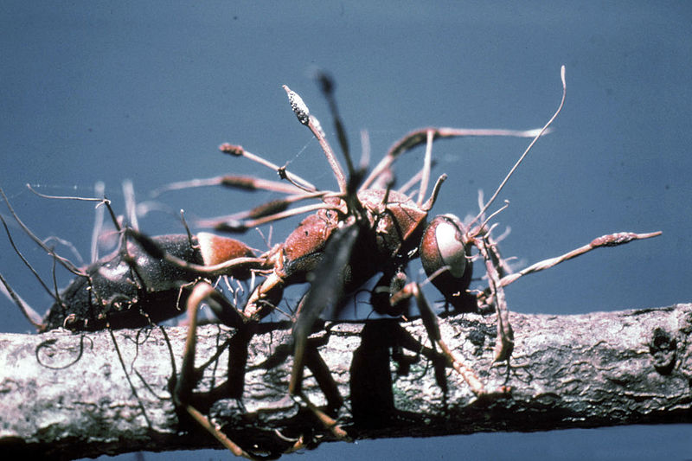

Slide 3
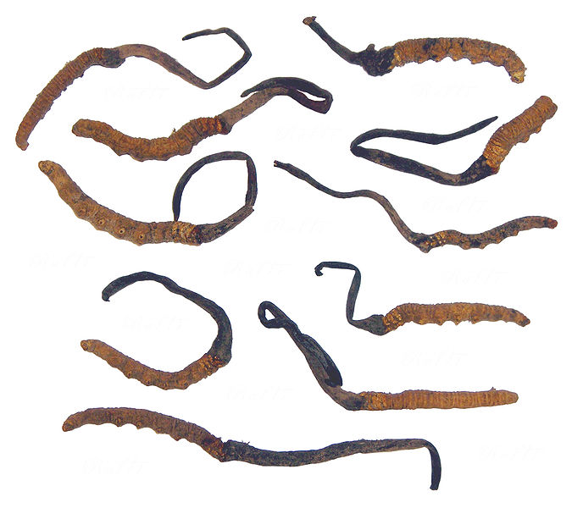

Slide 4
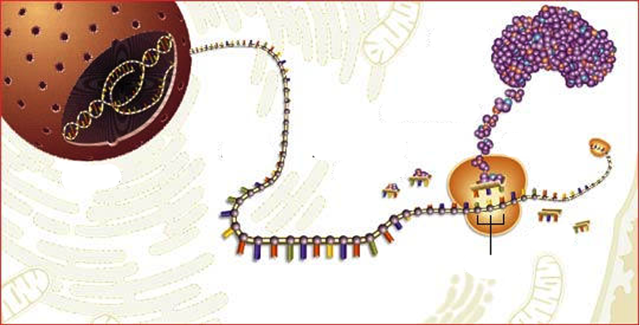
From DNA to Protein
mRNA
AAs
Ribosom
tRNA with AA
Codon
tRNA without AA
AA= AminoAcid
Notes:
PPT 11 Overview over the whole process
...later the single steps!!! (post it)

Slide 5
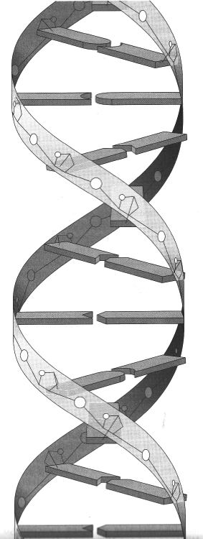
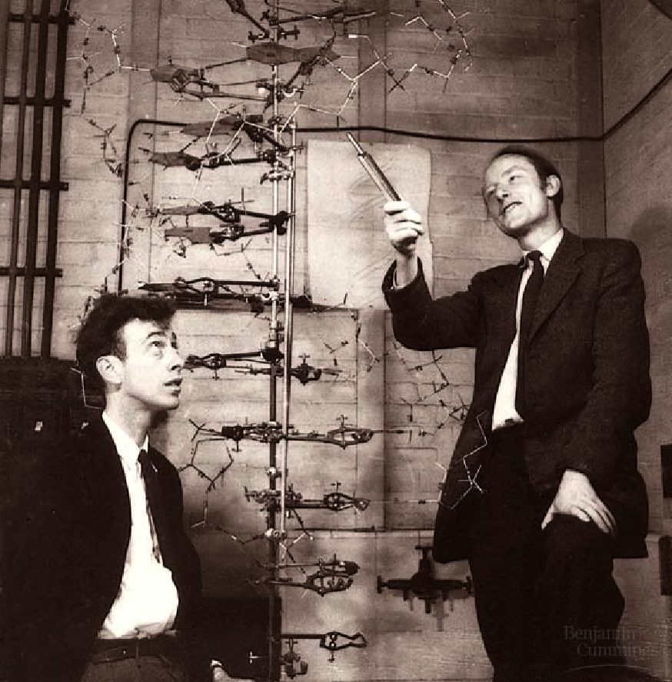
DNA
„Double Helix“
Watson and Crick 1953
→ Nobelprice in medicine

Slide 6
DNA

Slide 7
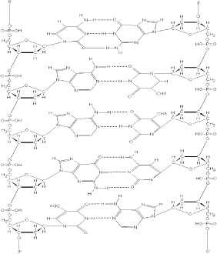
DNA: The molecule of life
5’ 3’
5’
3’

Slide 8
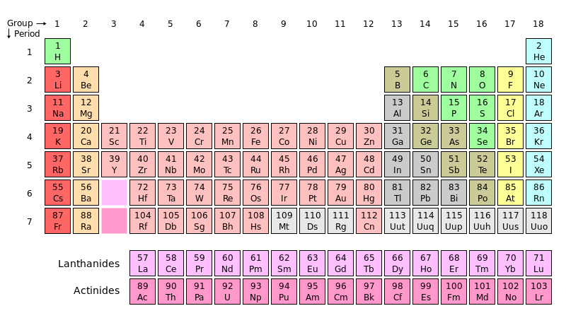
Periodic Table

Slide 10

Replication before Mitosis

Slide 11
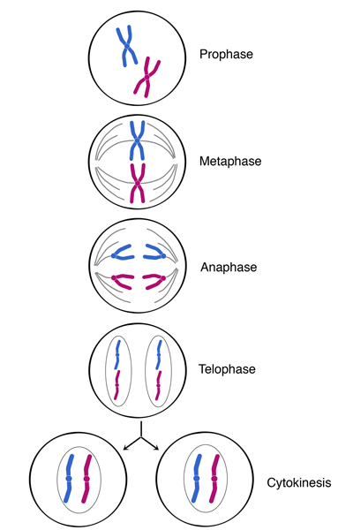
Cell divion:
Mitosis
(=nuclear division)
+
Cytokinesis
(=cytoplasmic division)

Slide 12
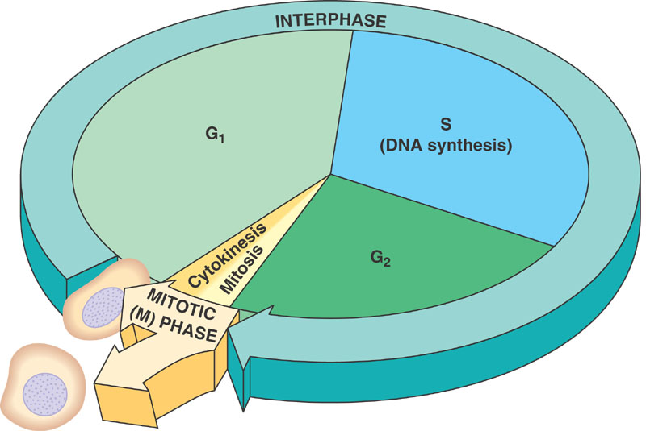
Cell Cycle
Notes:
interphase—during which the cell grows, accumulating nutrients needed for mitosis and duplicating its DNA
mitosis (M) phase, during which the cell splits itself into two distinct cells
cytokinesis, where the new cell is completely divided.

Slide 13
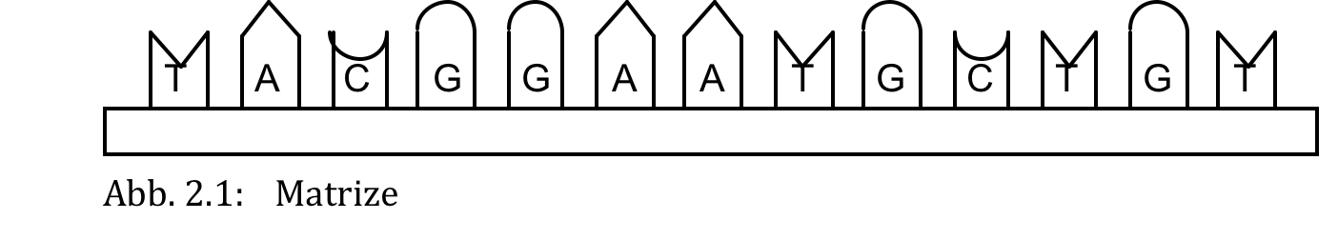
DNA

Slide 14
The basic concept of DNA Replication
a)
b)

Slide 15
c)

Slide 16
d)

Slide 17
Which result is correct?
A = G
b) A + G = C + T
c) A + T = G + T
d) A = C
e) G = T

Slide 18

3’
5’
DNA replication
(simple scheme)
③
①
②
5’
3’
5’
④
3’
⑤
⑤
3’
5’

Slide 19
Leading strand
DNA replication
(involved enzymes)
3’
5’
③
④
DNA-Polymerase
Direction of helicase
5’
②
Free Nucleotides
①
3’
③
Helicase
5’
Primase
Okazaki Fragment
⑤
⑥
Lagging strand
Ligase
3’
5’

Slide 20
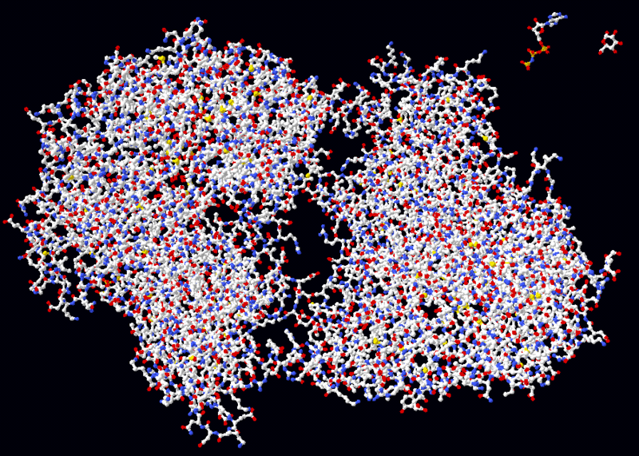
Helicase

Slide 21
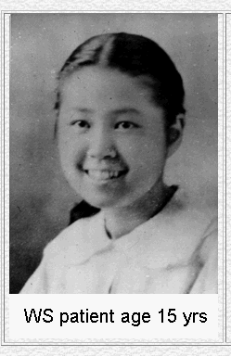
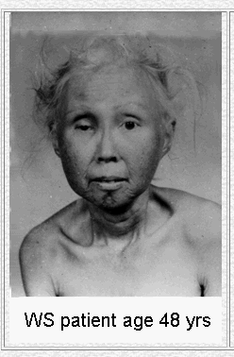
Defective Helicase Gene: Aging process accelerated

Slide 22
1 Origin of replication: prokaryotes

Slide 23
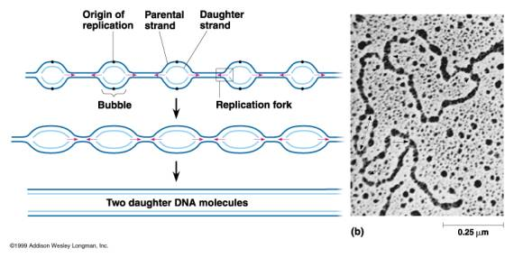
100- 1000 Origins of Replication: Eukaryotes

Slide 24
From Gene to Protein:
①
Transcription ④
②
Ala
Trp
Ser
② m-RNA
⑤ Translation
Glu
Ala
Ser
③
Ala
Leu
Val

Slide 25
Transcription: DNA → m-RNA
Transcription
Translation

Slide 26
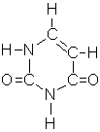
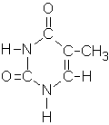
Organic bases
Uracil (RNA) Thymine (DNA)

Slide 27
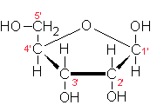
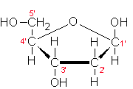
Sugars
Ribose (RNA) Desoxyribose (DNA

Slide 28
Transcription of DNA
②
5’
3’
②
3’
5’
3’
①
5’
③

Slide 29
Overview: From DNA (gene) to protein
Transcription
Translation

Slide 30
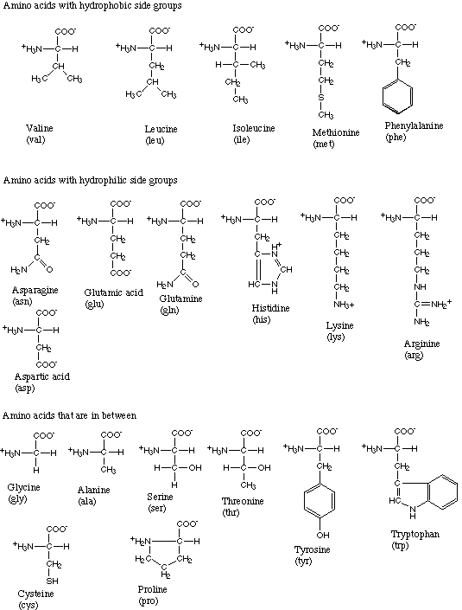

Slide 31
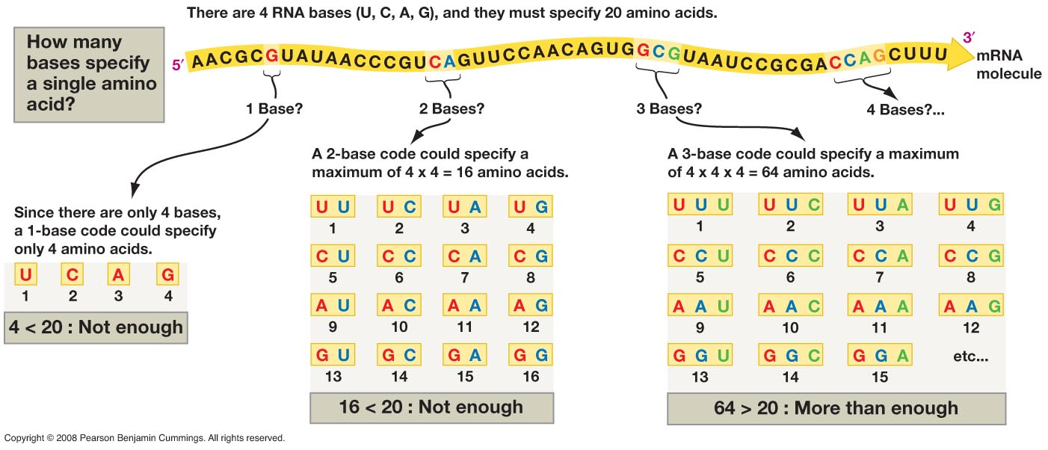
Genetic information is written as codons and translated into amino acid sequences.
Nucleotides are letters in a four-letter alphabet
How long are the words?

Slide 32
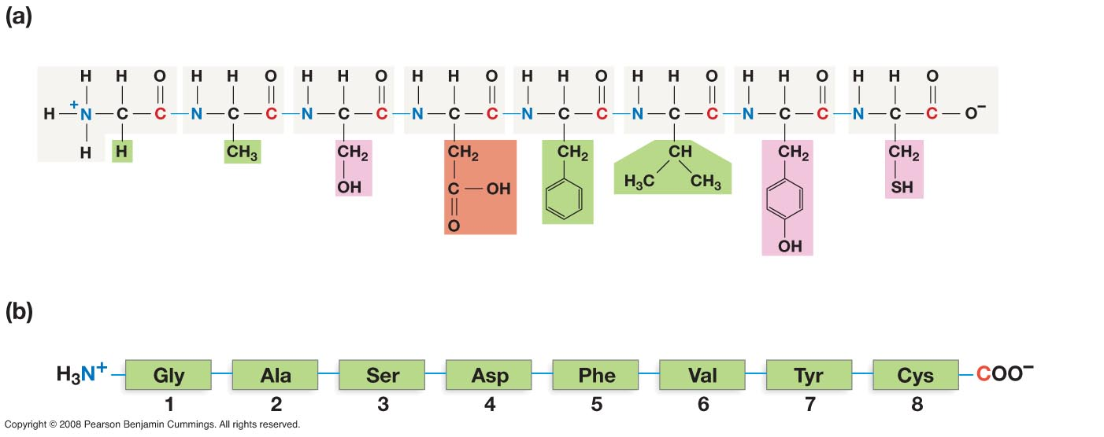
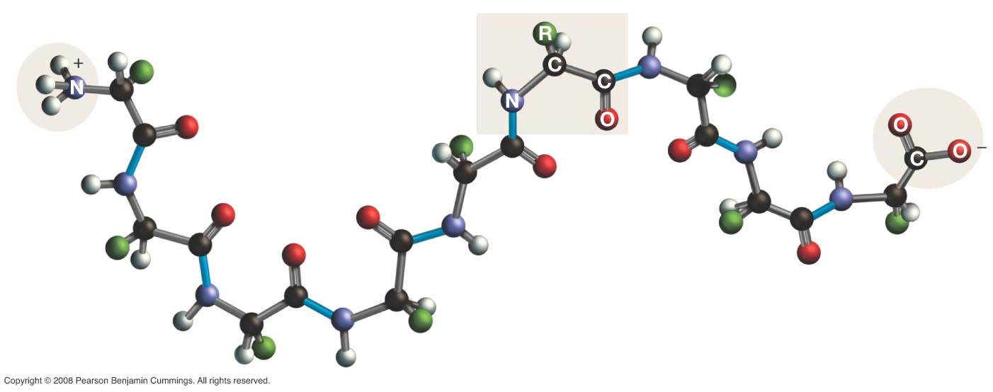
Primary Structure - the amino acid sequence
Notes:
The primary structure of a protein is the linear amino acid sequence. This sequence is created by the consecutive additions of amino acids to a growing polypeptide chain. The other levels of protein structure are dependent on the primary structure.
The primary structure is directional with one end called the amino terminus and the other end being called the carboxy terminus. This directionality is important for several reasons, not the least of which is that it reflects the direction in which protein synthesis occurred.

Slide 33
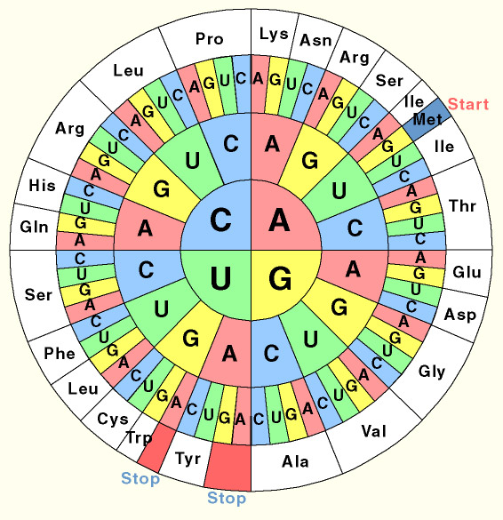
The Codon- Sun

Slide 34
EXERCISE: CODON SUN
1: Complement the table:

Slide 35
2) Determine all the triplets that stand for Leucin (Leu):
3) Translate the following m-RNA sequence into the
corresponding amino acid sequence:
RNA: 5’AUGGCCUCUUUCCAGCAUCACUGA3’
AA: __________________________________

Slide 36
4) Determine the amino acid sequence that is encoded
in the following DNA- sequence:
DNA: 3’ACCATGGGCAAA5’
: _____________________
: _________________________

Slide 37
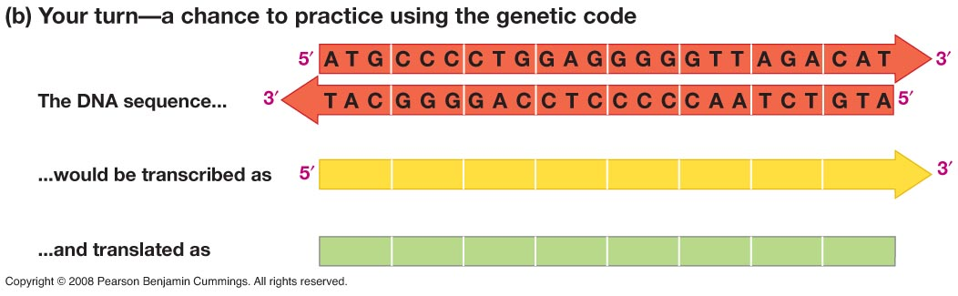
Exercise

Slide 38
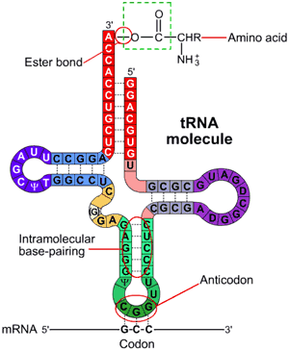
tRNA

Slide 39
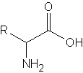
Amino acid

Slide 40
t- RNA
②
A
C
C
GA A
①

Slide 41
Stages of translation
A
Small subunit
m-RNA
5’
3’
U
U
AACCCA GCAAGACCCAA
U
ACGGAA
C
U
U
U
U
G
GGC
CGACCC A A
U
G
U
A C
Starter
t-RNA
MetMet

Slide 42
Stages of translation
B
5’
3’
AACCCAGCAACGACCCAA
U
ACGGAA
C
U
U
U
CGACCCAA
U
U
U
G
GGC
U
G
U
U
G G
A C
Met
Thr
Peptide bond

Slide 43
Stages of translation
C
The ribosome moves to the next base triplet
5’
3’
AACCCAGCAACGACCCAA
U
ACGGAA
C
U
G
U
GGC
U
CGACCCAA
G
U
U
U
U
U
G G
Thr
Gln
unloaded
t-RNA
Met

Slide 44
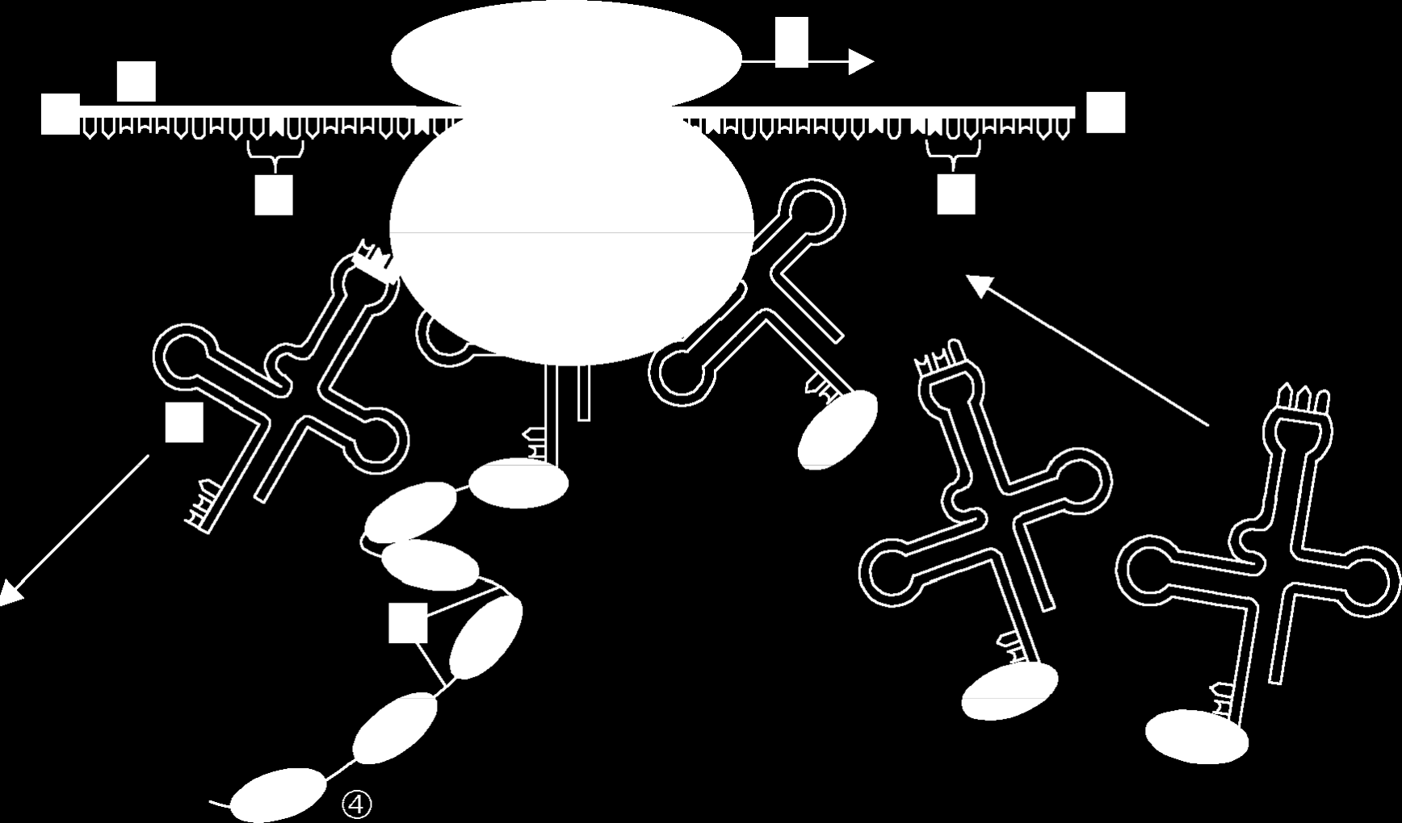
Translation: Overview

