Slide 1
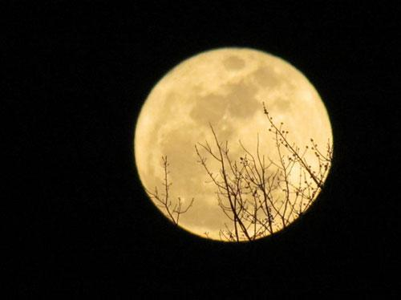
„Supermoon“
Night of the 5th to 6th May 2012
Notes:
During today’s night the Full Moon will appear especially big and bright compared to other Full Moons.

Slide 2
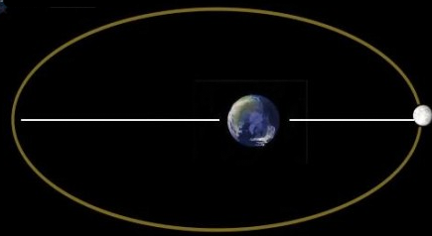
Lunar Orbit around the Earth
farest
closest
Notes:
The moon orbits the earth. How long does it take for one cycle? One month (29.5 days) .... By definition!!!
The orbit is not circular, but oval.
The Moon's distance varies each month between approximately 357,000 kilometers and 406,000 km due to its elliptical orbit around the Earth.
Distance Mundgod Delhi is about 1000km…. About 400 times the distance from here to delhi

Slide 3
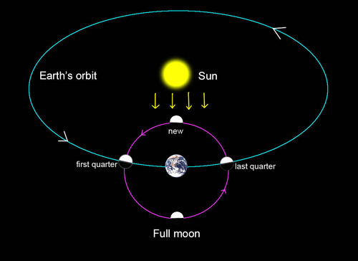
Full Moon
Notes:
The earth orbits the sun: How long for one cycle? 1 Year… by definition!!! 365,25 days
Full moon is a lunar phase that occurs when the Moon is on the opposite side of the Earth from the Sun. One time per month.

Slide 4
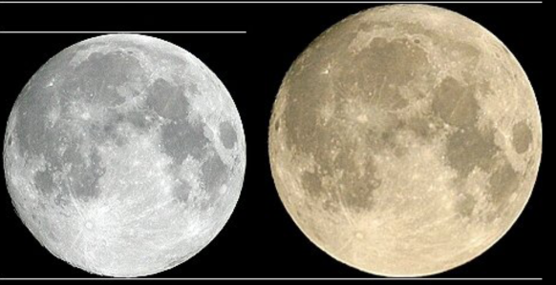
Distance Earth - Moon
Farest
Closest = Supermoon
405 000 km
357 000 km
Notes:
If these two events fall together: Supermoon (about once a year!)
Appears 14% bigger and 30% brighter than other Full moons! Take the chance to see it!
Best to experience the effect when it is low on the horizon.

Slide 5
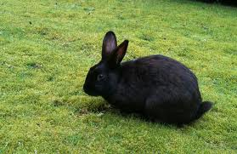
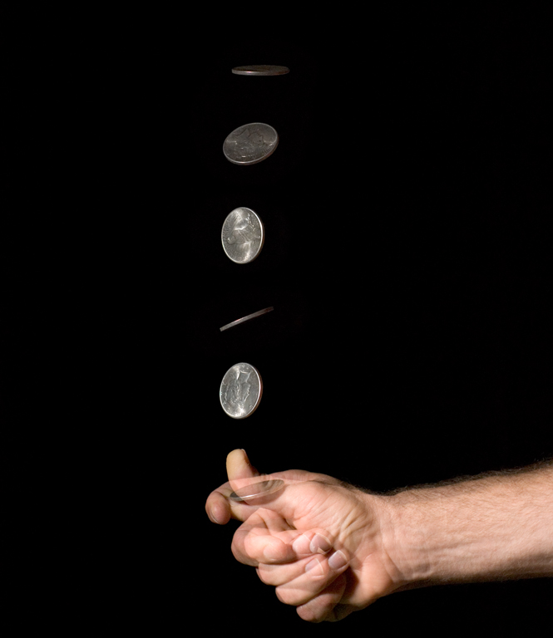
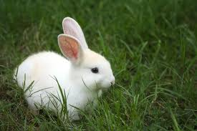

Mathematics: Probability (P)
Notes:
Doing Genetics and looking at family trees we came across the topic of probability. Mathematics is needed to do Biology!
Probability means how likely an event is going to happen.
For example:

Slide 6
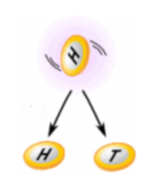
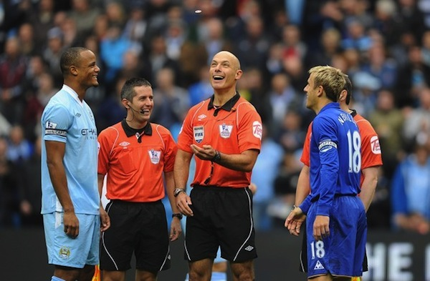
^{Example:}
What is the probability of getting a ^{"Head" when tossing a coin?}
0.5
0.5
RULE
Number of ways it can happen: 1 (Head)
Total number of outcomes: 2 (Head or Tail)
^{Probability (P) = 1/2 =} ^{0.5}

Slide 7

Example:
What is the probability of getting a ”5” or a “6" when rolling a dice?
Number of ways it can happen: 2 ("5" and "6")
Total number of outcomes: 6 ("1", "2", "3", "4", "5" and "6")
Probability (P) = 2/6 = 1/3 = 0.33

Slide 8
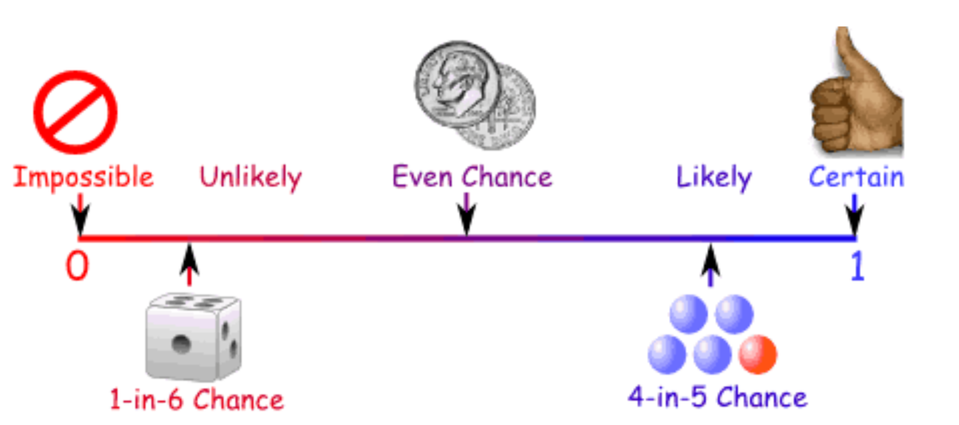
Ways of showing Probability (P)

Slide 9
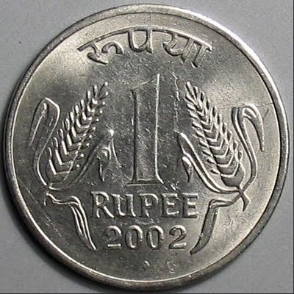
^{Example:}
Probability (P) of getting a ”Number up" when tossing a coin:
^{As a decimal: 0.5}
^{As a fraction: 1/2}
^{As a percentage: 50%}

Slide 10
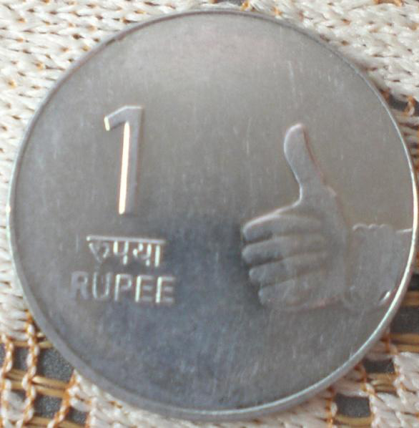
Probability
Two independent Events:
Two events , A and B, are independent if the fact that A occurs is NOT affecting the
probability of B occurring
                Example:
Landing „Number up“ after tossing a coin AND Landing „Number up“ after tossing
a second coin.
A B
RULE:
^{P(A and B) = P(A) ×} ^{P(B)}
^{= 1/2} ^{× 1/2} ^{= 1/4 = 25%}

Slide 11
Probability Test:
1.Tossing a coin.
2.Picking blindly between a red and and a differently coloured chromosome.
What is the probability for „Number up“ (A) AND picking the red chromosome (B)?
P(A) = 1/2 P(B) = 1/2
P (A+B) = 1/2 x 1/2 = 1/4 = 25%

Slide 12
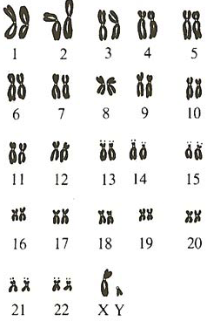
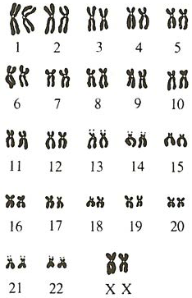
The 46 Human Chromosomes
Male
Female
Notes:
Sex-linked heredity: show if gene on X defect... Male can not compensate with second X.... Females can!!!
In females recessive... only if two copies defective.

Slide 13
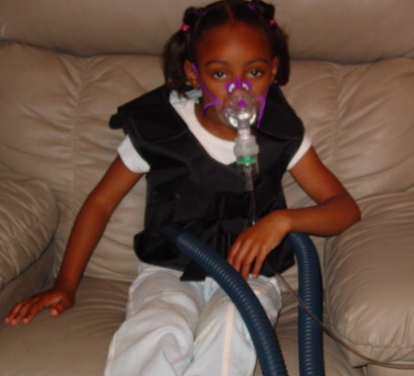
Human Genetic Disorders
Cystic Fibrosis:
- Monogenous
Autosomal
Recessive

Slide 14
Exercise
Imagine you would be a counsellor giving advice to a couple which is thinking of having a baby.
Carl was already married to another woman and they had a baby with cystic fibrosis.
The Brother of his present woman Helen died of cystic fibrosis.
ཁྱོད་རང་སློབ་སྟོན་པ་གཞི་ཡིན་པའི་ཚོད་དཔག་བྱེད་ནས་བཟའ་ཚང་ཕྲུ་གུ་དགོས་འདོད་པ་གཞི་ལ་བསླབ་བྱ་སྤྲོད།
ཀྲརལ་ནི་སྐྱེས་མ་གཞན་གཞི་མཉན་དུ་གཉེན་སྒྲིག་ཟིན་པ་དང་ཁོ་ཚོ་ལ་ཕྤུ་གུ་ གྲོད་ཁུག་གི་རྩ་རྒྱུས་སྐྲངས་ནད་པ་གཞི་ཡོད།
ད་ལྟ་ཁོ་རང་གི་སྐྱེས་མ་ཧ་ལེན་གྱི་གཅེན་པོ་གྲོད་ཁུག་གི་རྩ་རྒྱུས་སྐྲངས་ནད་ནས་འདས་གྲོངས་བྱིན།

Slide 15
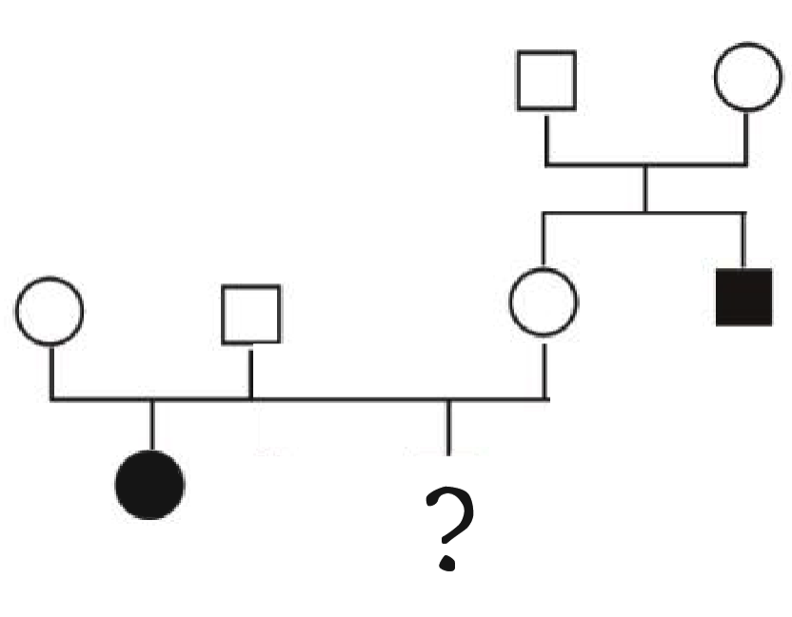
How big is the chance for them to have a baby with cystic fibrosis? _______________
ཁོ་རང་གཉིས་ལ་གྲོད་ཁུག་གི་རྩ་རྒྱུས་སྐྲངས་ནད་ཡོད་པའི་ཕྲུ་གུ་ཉེན་ཁ་ཇི་ལྟར་ཆེན་པོ་ཡོད་དམ། _______________
c = cystic fibrosis allele
C = normal allele
Cc
Cc
Carl
Helen
CC
or
Cc
Cc
Cc
cc
cc

Slide 16
P (Cc): 2/3
Genotype of Helen ?
Father Mother | C | c
C | CC | Cc
c | Cc | cc

Slide 17
P (cc): 1/4
Child with Cystic Fibrosis
Carl Helen | C | c
C | CC | Cc
c | Cc | cc

Slide 18
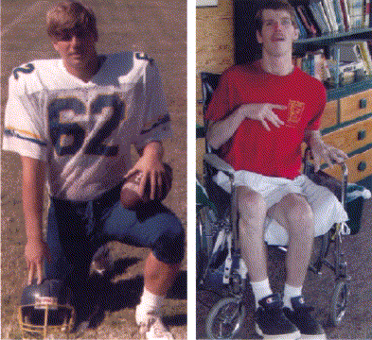
Chorea Hutington Patient
- monogenous
- autosomal
- dominant
18 years
33 years

Slide 19
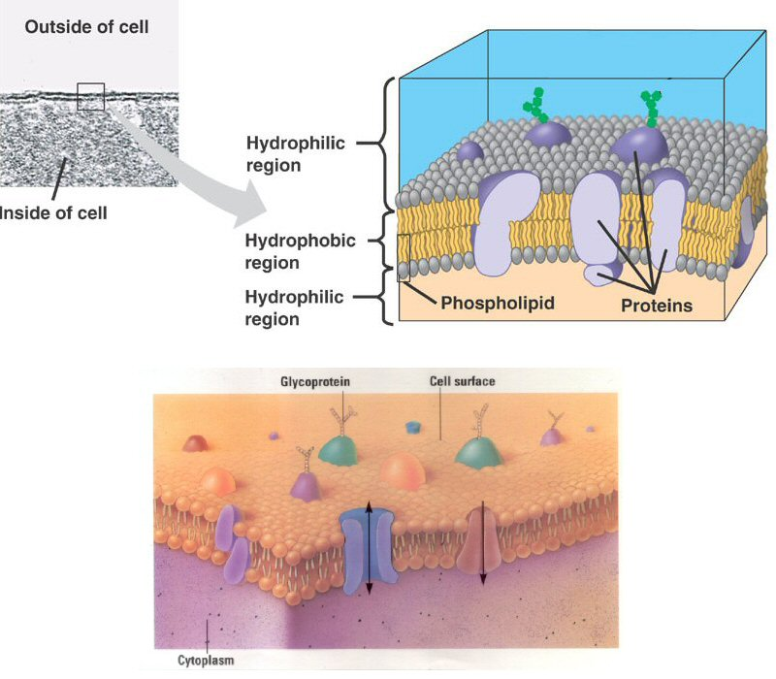
Cell membrane proteins:
→ control of transport into and out of the cell

Slide 20
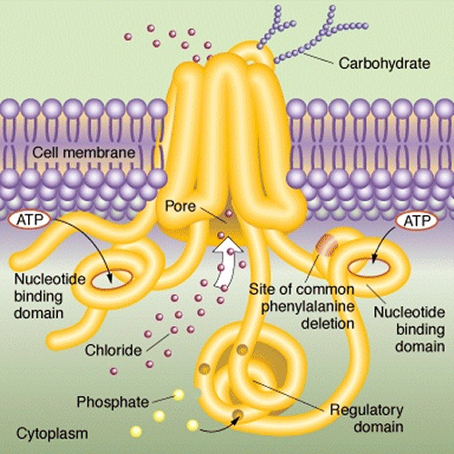
Chlorid channel

Slide 21
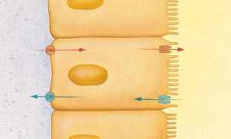
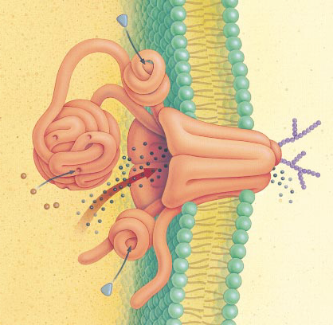
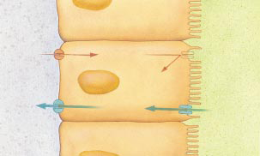
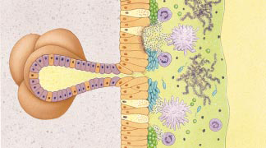
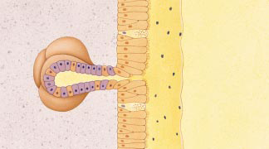
Effect on Lungs
Chloride channel
transports salt through protein channel out of cell
Osmosis: H₂O follows Cl–
normal lungs
airway
Cl–
Cl– channel
H₂O
cells lining lungs
cystic fibrosis
Cl–
H₂O
bacteria & mucus build up
thickened mucus
hard to secrete
mucus secreting glands

Slide 22
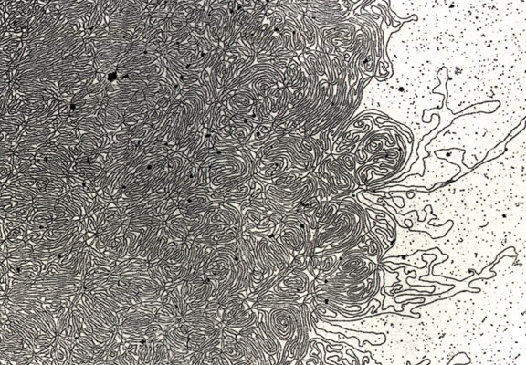
DNA- „Thread“

Slide 23
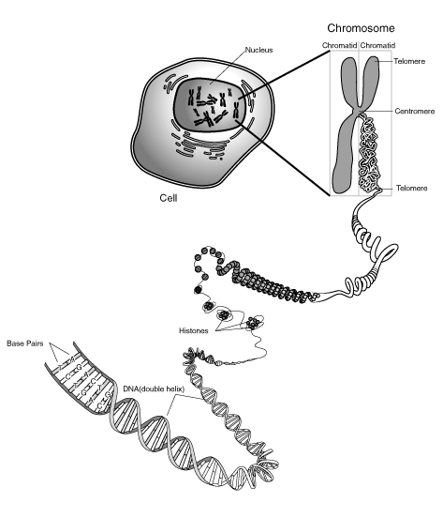
Notes:
Skin, muscle, and nerve cells are some examples of human somatic cells. They display a big variation in form and function, but all of them store their genetic information in the cell nucleus. Structures, called chromosomes, are the carriers of this information. They consist of a long, very thin „thread“ of DNA, in which this information is encoded.

